Slide 1
Assignment : 4
Agentic AI Publish/Subscribe Assignment

Slide 2
Kafka Pub/Sub with 3 Agents (LLM-Powered Worker)
Objective:
Build an asynchronous pub/sub architecture where agents communicate through Kafka topics.
Requirements implemented:
- Kafka used as the pub/sub broker
- 3 agents publish/subscribe to chosen topics
- Agents are decoupled (publishers and subscribers don’t know each other)
- WorkerAgent uses an LLM (OpenAI API) to process tasks and generate results

Slide 3
What is Pub/Sub?
Pub/Sub (Publish/Subscribe) is an asynchronous messaging pattern:
- Publishers send messages to a broker under a topic (not to specific receivers)
- Subscribers listen to topics they are interested in
- Publishers do not know who consumes the message
- Subscribers do not know who produced the message
Benefits:
Decoupling, scalability, event-driven communication, and easier expansion of agent systems.

Slide 4
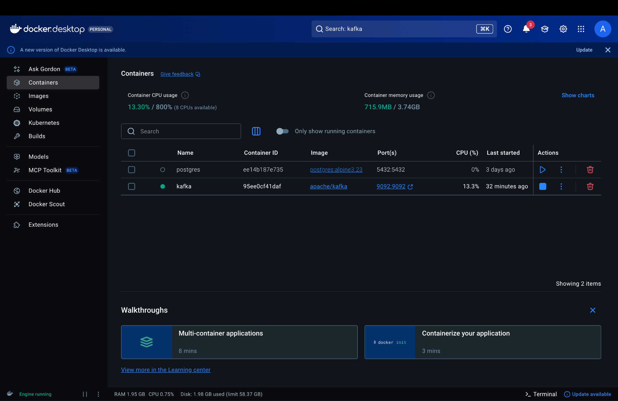
Kafka as the Pub/Sub Broker
Kafka provides topic-based pub/sub messaging:
- Producers publish events to Kafka topics
- Consumers subscribe to topics and process messages asynchronously
- Kafka persists messages and supports scaling via partitions and consumer groups
In this system:
Kafka is the only communication channel between agents.

Slide 5
Architecture: 3 Agents + 2 Topics
Topics:
- "tasks": task/event stream
- "results": processed output stream
Agents:
1) PlannerAgent (Publisher)
- Publishes tasks to topic "tasks"
2) WorkerAgent (Subscriber + Publisher)
- Subscribes to "tasks"
- Uses OpenAI (GPT) to process tasks
- Publishes outputs to topic "results"
3) MonitorAgent (Subscriber)
- Subscribes to both "tasks" and "results"
- Logs all events as an audit trail

Slide 6
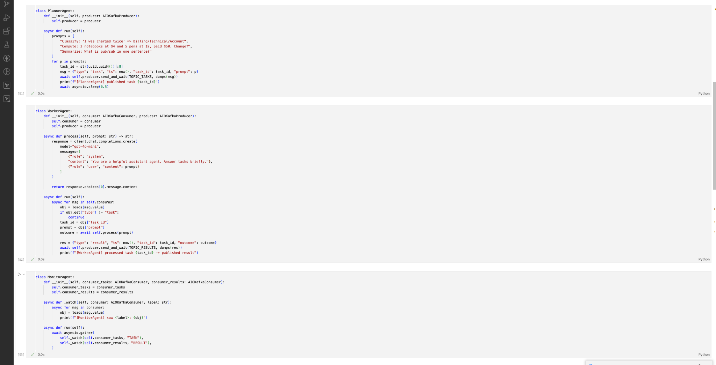
Implementation Details (asyncio + aiokafka + OpenAI)
Implementation tools:
- asyncio: runs all agents concurrently (non-blocking)
- aiokafka: async Kafka Producer/Consumer
- JSON messages: encoded to bytes for Kafka transport
- OpenAI API: WorkerAgent calls GPT to generate outcomes
Key point:
Agent behavior is independent; Kafka handles routing and delivery via topics.

Slide 7
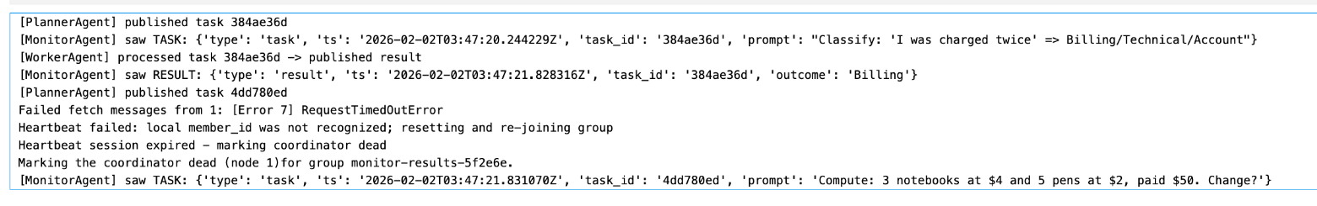
Demo Output + Conclusion
Demo evidence (from notebook logs):
- PlannerAgent publishes tasks to "tasks"
- WorkerAgent consumes tasks and publishes results to "results"
- MonitorAgent sees both TASK and RESULT messages
Conclusion:
This demonstrates a Kafka-based pub/sub agent system where communication is asynchronous and decoupled.
Using an LLM in WorkerAgent shows a realistic AI agent pipeline: tasks are distributed via Kafka and solved by GPT.

